Slide 1
CND212: Digital Testing and Verification

Slide 2
OOP Revision
Class encapsulates:
Variables (properties)
Subroutines (methods)
Object: instance of a class.
Class constructors: Allocate memory for the object using the new() method.
Object members are accessed using the (.) notation.
Class members
Class
Object
Properties
Methods
Object

Slide 3
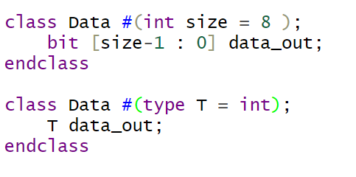
OOP: Parameterized Classes
Parameters used for objects customization during compile time.
Can be value parameter or type parameter.

Slide 4
OOP: Inheritance
Any class can be extended to add more properties and/or methods
If the method of the parent class is overridden in the child class, then using the ‘super’ keyword parent class method can be accessed from the child class.
Base Class
Child Class
Properties
Properties
Methods
Methods
Properties
Methods

Slide 5
OOP: Remember
Static variables has one copy in all class instances.
Static methods can be called without class instantiation and has access to static members only.
Virtual class is a class that you cannot create an object from.
Virtual methods: in case of identical function names between base and child class, using virtual methods allow access to the child class methods.
this keyword: predefined object handle that refers to the current object

Slide 6

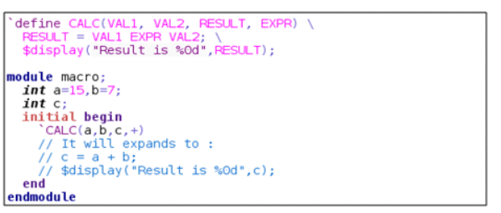
OOP: `define macro
`define macro in systemverilog is a directive that allows you to define a shorthand or alias for a block of code.
Single line macro
Multiline macro:

Slide 7
Introduction to UVM

Slide 8
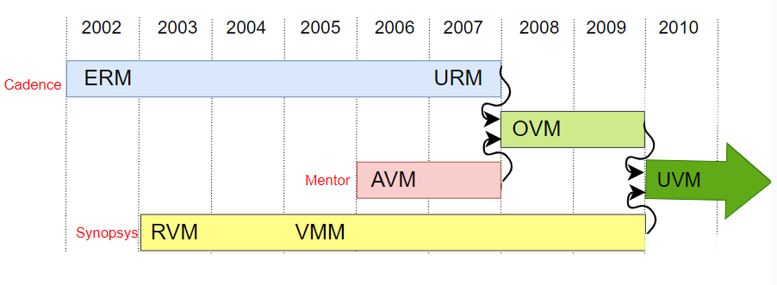
UVM: What is UVM?
Universal Verification Methodology.
Class base library defined using systemverilog.
Maintained by Accellera.
Supported by multiple EDA vendors (Mentor, Synopsys, Cadence)
Notes:
URM:Universal Reuse Methodology
AVM:Advanced Verification Methodology
OVM: Open Verification Methodology
RVM:Reuse Verification Methodology
VMM: Verification Methodology Manual

Slide 9
Why UVM?
Pre-defined base classes library with built in methods
Standardized methodology
Reusability
Modularity
Scalability
Configurability
Separate test from testbench

Slide 10
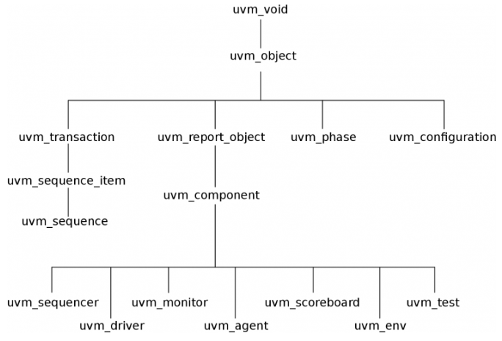
UVM Class Hierarchy
The UVM Class Library provides all the building blocks needed to quickly developed, well-constructed, reusable, testbench components.

Slide 11
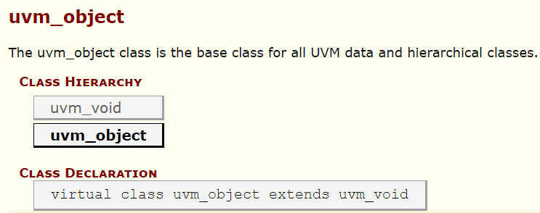
UVM Class Hierarchy
UVM void
The base class for all UVM classes.
It is an abstract class with no data members or functions.
UVM object
The base class available for component and sequence branch.
Provides methods like create, clone, copy, record, compare, print, etc.

Slide 12
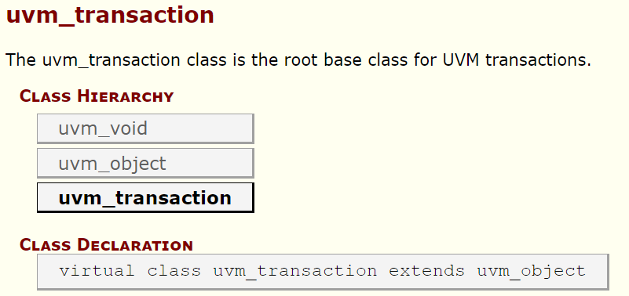
UVM Class Hierarchy
UVM report object
Provides reporting functionality for UVM.
UVM transaction
Used for generating stimulus and its analysis.
They are transient in nature.

Slide 13
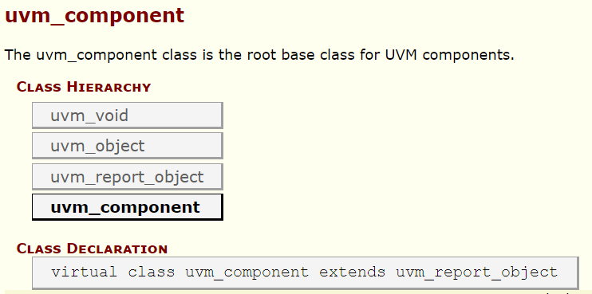
UVM Class Hierarchy
UVM component
The uvm_component class is the root base class for all UVM components. Components are static objects that exist throughout simulation.
Class constructor new() needs the instance name and handle to its parent.
All classes derived from uvm_component must call super.new(name,parent).

Slide 14
UVM Class Hierarchy
UVM component provides many features like:
Hierarchy: Provides methods for searching and traversing component hierarchy. (get_parent, get_full_name)
Phasing: UVM defines a set of simulation phases that enable users to control the order in which testbench components are created, initialized, and executed. This allows all components to execute in synchronization.
Reporting: Provides an interface to uvm_report_handler to process all messages, errors, and warnings.

Slide 15
UVM Class Hierarchy
UVM component provides many features like:
Objection: Provides an interface to the uvm_objection mechanism.
Configuration: UVM provides a configuration database that allows users to store and retrieve configuration information for testbench components
Factory: Provides an interface to the uvm_factory to create new components and objects. This also allows an override mechanism for components and objects. Will be discussed later.
Default constructor for uvm_component has two arguments: name and parent.
Default constructor for uvm_object has a single argument: name

Slide 16
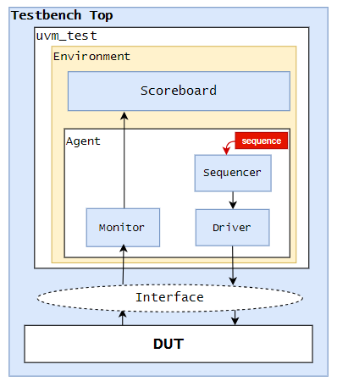
UVM Testbench Hierarchy
The UVM employs a layered, object-oriented testbench hierarchy that allows “separation of concerns” among the various team members.

Slide 17
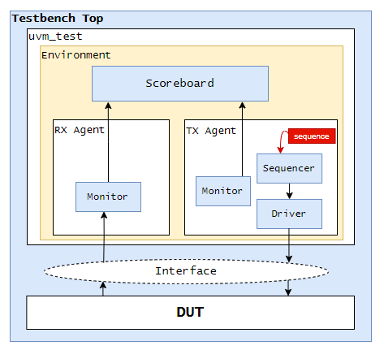
UVM Testbench Hierarchy
Notes:
Another implementation

Slide 18
UVM Testbench Top
The testbench top is a static container that has an instantiation of DUT and interfaces.
The interface instance connects with DUT signals in the testbench top.
The clock is generated and initially reset is applied to the DUT.
UVM testbench top is also used to trigger a test using run_test() call.

Slide 19
UVM Testbench Top
// Instantiate design top
adder DUT(.clk(vif.clk),
.reset(vif.reset),
.in1(vif.ip1),
.in2(vif.ip2),
.out(vif.out)
);
initial begin
// set interface in config_db
uvm_config_db#(virtual add_if)::set(uvm_root::get(), "*", "vif", vif);
// Dump waves
$dumpfile("dump.vcd");
$dumpvars;
end
initial begin
run_test("base_test");
end
endmodule
`include "uvm_macros.svh"
import uvm_pkg::*;
module tb_top;
bit clk;
bit reset;
always #5 clk = ~clk;
initial begin
clk = 0;
reset = 1;
#5;
reset = 0;
end
add_if vif(clk, reset);

Slide 20
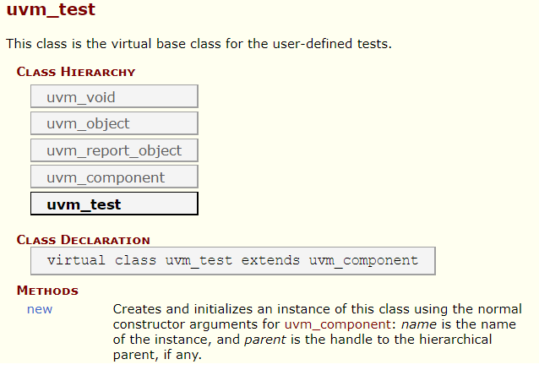
UVM Test
The top-level UVM Component in the UVM Test bench.
Instantiates the top-level environment and configures it.
Implement run phase to start sequences on required sequencers with raise/drop objection callbacks.

Slide 21
UVM Test
class my_test extends uvm_test;
env env_o;
base_seq bseq;
`uvm_component_utils(my_test)
// constructor
function new(string name = "my_test", uvm_component parent = null);
super.new(name, parent);
endfunction
function void build_phase(uvm_phase phase);
super.build_phase(phase);
env_o = env::type_id::create("env_o", this);
endfunction
task run_phase(uvm_phase phase);
phase.raise_objection(this);
bseq = base_seq::type_id::create("bseq");
repeat(10) begin
#5; bseq.start(env_o.agt.seqr);
end
phase.drop_objection(this);
`uvm_info(get_type_name, "End of testcase", UVM_LOW);
endtask
endclass

Slide 22
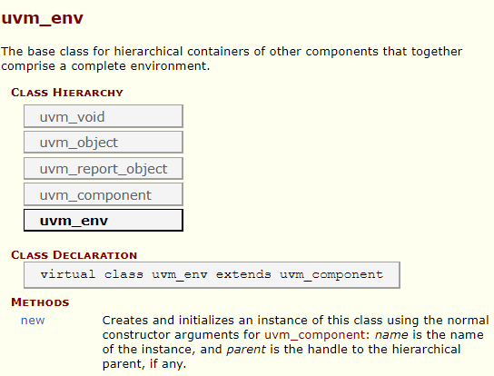
UVM Environment
The UVM Environment is a higher-level verification and hierarchical component that groups together other verification components that are interrelated.
The top-level UVM Environment encapsulates all the verification components targeting the DUT like UVM Agents, UVM Scoreboards, or even other UVM Environments.

Slide 23
UVM Environment
class env extends uvm_env;
`uvm_component_utils(env)
agent agt;
scoreboard sb;
func_cov fcov;
function new(string name = "env", uvm_component parent = null);
super.new(name, parent);
endfunction
function void build_phase(uvm_phase phase);
super.build_phase(phase);
agt = agent::type_id::create("agt", this);
sb = scoreboard::type_id::create("sb", this);
fcov = func_cov::type_id::create("fcov", this);
endfunction
function void connect_phase(uvm_phase phase);
// connect agent and scoreboard using TLM interface
// Ex. agt.mon.item_collect_port.connect(sb.item_collect_export);
endfunction
endclass

Slide 24
UVM Agent
The UVM agent is a hierarchical component that contains UVM Sequencer, UVM Driver, and UVM Monitor that are dealing with a specific DUT interface.
UVM Agents might include other components, like coverage collectors, protocol checkers, a TLM model, etc.
The UVM environment may contain more than one agent. The agent can initiate the transactions to the DUT or react to the transaction requests.
There are two types of agents:
Active
Passive

Slide 25
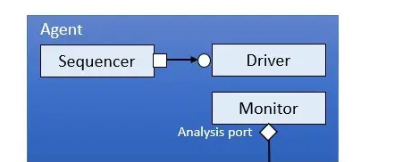
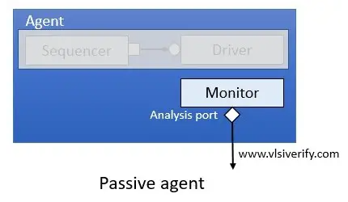
UVM Agent
Active agent stimulates the DUT by driving transactions and monitors the device. It instantiates all three components driver, monitor, and sequencer.
Passive agent does not drive stimulus to the DUT. It instantiates only a monitor component. It is used as a sample interface for coverage and checker purposes.

Slide 26
UVM Agent
class a_agent extends uvm_agent;
driver drv;
sequencer seqr;
monitor_A mon_A;
`uvm_component_utils(a_agent)
function new(string name = "a_agent", uvm_component parent = null);
super.new(name, parent);
endfunction
function void build_phase(uvm_phase phase);
super.build_phase(phase);
if(get_is_active() == UVM_ACTIVE) begin
drv = driver::type_id::create("drv", this);
seqr = sequencer::type_id::create("seqr", this);
`uvm_info(get_name(), "This is Active agent", UVM_LOW);
end
mon_A = monitor_A::type_id::create("mon_A", this);
endfunction
function void connect_phase(uvm_phase phase);
super.connect_phase(phase);
if(get_is_active() == UVM_ACTIVE)
drv.seq_item_port.connect(seqr.seq_item_export);
endfunction
endclass

Slide 27
UVM Sequence Items
Generate stimulus and has control capabilities for the sequence-sequencer mechanism.
class seq_item extends uvm_seqeunce_item;
rand int value;
rand color_type colors;
rand byte data[4];
rand bit [7:0] addr;
`uvm_object_utils_begin(my_object)
`uvm_field_int(value, UVM_ALL_ON)
`uvm_field_string(names, UVM_ALL_ON)
`uvm_field_enum(color_type, colors, UVM_ALL_ON)
`uvm_field_sarray_int(data, UVM_ALL_ON)
`uvm_field_int(addr, UVM_ALL_ON)
`uvm_object_utils_end
function new(string name = "my_object");
super.new(name);
endfunction
endclass

Slide 28
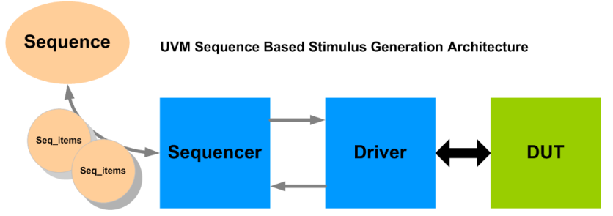
UVM Sequence
UVM sequence is a container that holds data items (uvm_sequence_items) which are sent to the driver via the sequencer.
Can be transient or persistent.
To operate, each UVM Sequence is eventually bound to a UVM Sequencer.
Multiple UVM Sequence instances can be bound to the same UVM Sequencer

Slide 29
UVM Sequence
class my_sequence extends uvm_sequence #(my_seq_item);
`uvm_object_utils(my_sequence)
function new(string name = "my_sequnce");
super.new(name);
endfunction
task body();
...
endtask
endclass
task body();
`uvm_do(seq1); // calling seq1
`uvm_do(seq2); // calling seq2
Endtask
task body();
req = seq_item::type_id::create("req");
wait_for_grant();
assert(req.randomize());
send_request(req);
wait_for_item_done();
get_respose(rsp);
endtask
task body();
`uvm_create(req);
assert(req.randomize());
`uvm_send(req);
endtask

Slide 30
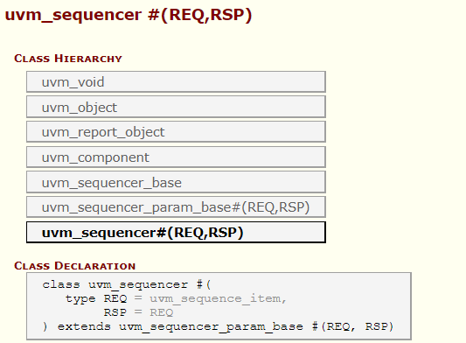
UVM Sequencer
The UVM sequencer behaves as an arbiter for controlling transaction flow from multiple stimulus sequences.
Also controls the flow of UVM Sequence Items generated by one or more UVM Sequences.
The uvm_sequencer class is a parameterized class of type REQ sequence_item and RSP sequence item. RSP sequence item is optional.
Notes:
user-defined sequencer is recommended to extend from the parameterized base class “uvm_sequencer” which is parameterized by request (REQ) and response (RSP) item types. Response item usage is optional. So, mostly sequencer class is extended from a base class that has only a REQ item.

Slide 31
UVM Sequencer
class my_sequencer extends uvm_sequencer #(data_item);
`uvm_component_utils(my_sequencer)
function new (string name, uvm_component parent);
super.new(name, parent);
endfunction
endclass

Slide 32
UVM Driver
The UVM Driver receives the sequence Item transactions from the UVM Sequencer and applies it on the DUT Interface.
The uvm_driver class is a parameterized class of type REQ sequence_item and RSP sequence item. RSP sequence item is optional.
The sequencer and driver communicate with each other using a bidirectional TLM interface to transfer REQ and RSP sequence items.

Slide 33
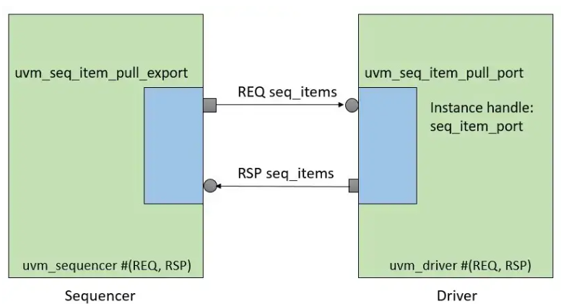
UVM Driver
The driver has uvm_seq_item_pull_port which is connected with uvm_seq_item_pull_export of the associated sequencer.
The TLM connection between driver and sequencer is one-to-one connection. It means neither multiple sequencers are connected to a single driver nor multiple drivers connected to a single sequencer.

Slide 34
UVM Driver
class driver extends uvm_driver#(seq_item);
virtual add_if vif;
`uvm_component_utils(driver)
function new(string name = "driver", uvm_component parent = null);
super.new(name, parent);
endfunction
function void build_phase(uvm_phase phase);
super.build_phase(phase);
if(!uvm_config_db#(virtual add_if) :: get(this, "", "vif", vif))
`uvm_fatal(get_type_name(), "Not set at top level");
endfunction
task run_phase (uvm_phase phase);
// Get the sequence_item and drive it to DUT
endtask
endclass
task run_phase (uvm_phase phase);
forever begin
seq_item_port.get_next_item(req);
// Driving logic
...
seq_item_port.item_done();
end
endtask
task run_phase (uvm_phase phase);
forever begin
seq_item_port.get(req);
// Driving logic
...
seq_item_port.put(rsp_item);
end
endtask

Slide 35
UVM Monitor
A UVM monitor is a passive component used to capture DUT signals using a virtual interface and translate them into a sequence item format.
These sequence items or transactions are broadcasted to other components like the UVM scoreboard, coverage collector, etc.
It uses a TLM analysis port to broadcast transactions.
The uvm_analysis_port is a specialized TLM based class whose interface consists of a single function write () and can be embedded within any component.
This port contains a list of analysis exports that are connected to it, When the monitor calls analysis_port.write(), it basically cycles through the list and calls the write() method of each connected export.

Slide 36
UVM Monitor
class monitor extends uvm_monitor;
// declaration for the virtual interface, analysis port, and monitor sequence item.
virtual add_if vif;
uvm_analysis_port #(seq_item) item_collect_port;
seq_item mon_item;
`uvm_component_utils(monitor)
// constructor
function new(string name = "monitor", uvm_component parent = null);
super.new(name, parent);
item_collect_port = new("item_collect_port", this);
mon_item = new();
endfunction
function void build_phase(uvm_phase phase);
super.build_phase(phase);
if(!uvm_config_db#(virtual add_if) :: get(this, "", "vif", vif))
`uvm_fatal(get_type_name(), "Not set at top level");
endfunction
task run_phase (uvm_phase phase);
forever begin
// Sample DUT information and translate into transaction
item_collect_port.write(mon_item);
end
endtask
endclass

Slide 37
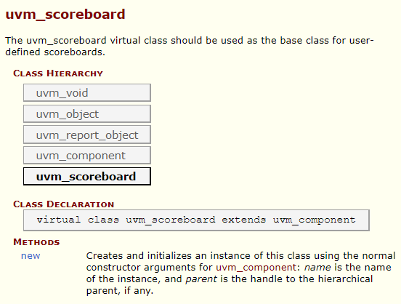
UVM Scoreboard
The UVM Scoreboard checks the behavior of a certain DUT.
mIt usually receives transactions carrying inputs and outputs of the DUT through UVM Agent analysis ports, runs the input transactions through a reference model (also known as the predictor) to produce expected transactions, and then compares the expected output versus the actual output.

Slide 38
UVM Scoreboard
class scoreboard extends uvm_scoreboard;
uvm_analysis_imp #(seq_item, scoreboard) item_collect_export;
seq_item item_q[$];
`uvm_component_utils(scoreboard)
function new(string name = "scoreboard", uvm_component parent = null);
super.new(name, parent);
item_collect_export = new("item_collect_export", this);
endfunction
function void build_phase(uvm_phase phase);
super.build_phase(phase);
endfunction
function void write(seq_item req);
`uvm_info(get_type_name, $sformatf("Received transaction = %s", req), UVM_LOW);
item_q.push_back(req);
endfunction
task run_phase (uvm_phase phase);
seq_item sb_item;
forever begin
wait(item_q.size > 0);
if(item_q.size > 0) begin
sb_item = item_q.pop_front();
// Checking comparing logic
...
end
end
endtask
endclass

Slide 39
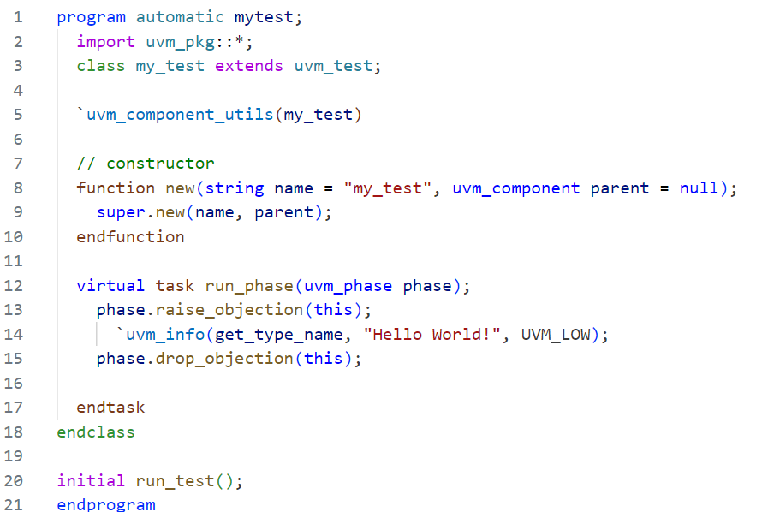
Try Building a Simple UVM Test
Compile using:
vcs -sverilog -ntb_opts uvm-1.2 mytest.sv
./simv +UVM_TESTNAME=my_test

Slide 40
Thank you

